Slide 1
Automatically Encoding critical editions of Latin Texts
Virginia K. Felkner
University of Oklahoma

Slide 2
AUTOMATION: Previous work
Notes:
In this section, I will discuss my previous work in automating the encoding of prose, poetry, drama, and mixed matter text.
During this discussion, I will give a general overview of how the DLL Automation process works, as well as discussing the algorithm used for wrapping simpler texts in XML.

Slide 3
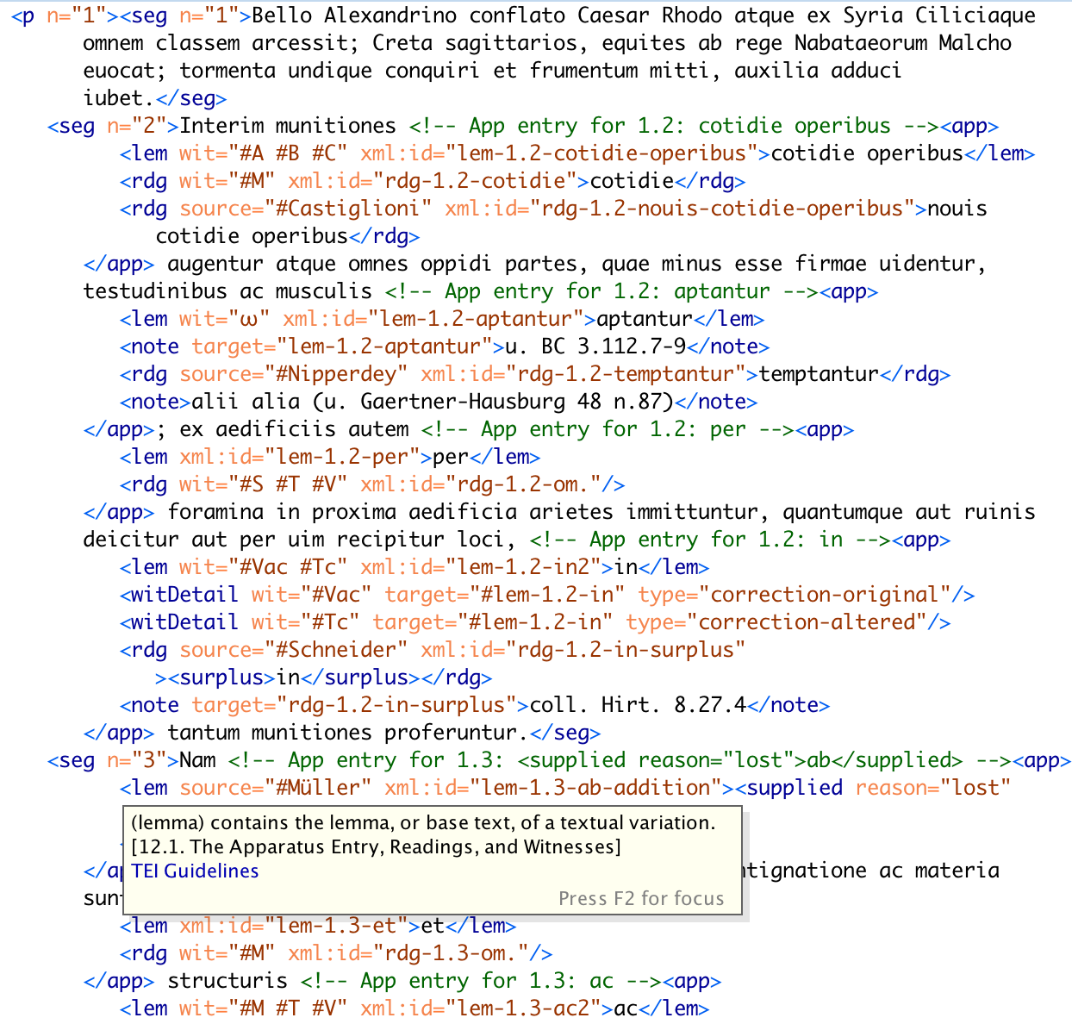
Notes:
This is what DLL is already doing
A traditional critical edition, which includes an edited version of an ancient text and possible alternate readings, is visually encoded data which is understandable by a person with relevant background. It is not machine readable.
An XML-encoded edition is a machine readable representation of the same textual data. It allows us to use computers to visualize, analyze, and better understand the text.
I have already developed a Python script to automate this process for simpler texts, like Caesar,.
why do we want to do this?
Other panelists have talked about what we can do with XML critical editions, and why this is a sustainable way of storing and sharing textual data.
For the remainder of my talk, I will be discussing where these XML texts come from.
in a perfect world, all digital editions would be published in perfect XML by editors who love hand-typing thousands of angle brackets. Unfortunately, these editors don't exist.
Raise your hand if you enjoy typing hand-typing thousands of angle brackets!
As you can see, asking editors to hand-type XML is not viable. That’s where I come in! I have written a set of Python scripts that automate the XML encoding process for a variety of texts.

Slide 4
HOW IT WORKS
DLL Automation is designed to be easy for editors to use. Input files are:
Plain text (.txt) version of the editor’s text
Spreadsheet (.csv) of the critical apparatus
Simple algorithm
Using sentence numbers as delimiters, we go through the text and wrap each sentence in a tag.
Internally, we represent the text as a big string and use find/replace operations
Then, process the CSV row-by-row, again using find/replace on strings
Notes:
Ease of use
We want creating an LDLT critical edition to be intuitive for editors. Therefore, our input files are designed to be as similar to a print critical edition as possible. In particular, the CSV closely mirrors the format of a printed critical apparatus entry. We take the burden of digital formatting off of the editor and allow them to focus on their argument about the text.
Dr. Huskey originally developed these input formats, but I have done a lot of work in refining them to deal with a wider variety of texts and critical annotations. I have also written guidelines and example inputs for all types of text.
Simple Automation Algorithm
We go through the text sequentially 2 times, first wrapping paragraphs with the appropriate XML tag, then wrapping sentences in XML tags.
Text is represented internally as a big string and we use simple find and replace operations to insert the tags
i.e. find a paragraph number, replace it with a closing tag for the last paragraph followed by an opening tag for this paragraph.
This simple algorithm is dependent on the text having a predictable structure and having all sections properly numbered.
Once the baese text is encoded, we process the CSV row-by-row, using simple find and replace operations on one sentence at a time

Slide 5
Servius
Automation Round 2: This Time It’s Personal
Notes:
In this section, I will discuss my recent work on automatically generating a critical edition of books 9-12 of Murgia and Kaster’s critical edition of Servius.
I will begin by discussing how Servius is different from other texts, and why a fundamentally different computational approach is necessary.
I will then discuss how I approached the problem by using the fundamental concepts of object oriented programming. I will provide a detailed explanation of how the script works and why I chose to process Servius in this way. I will also briefly discuss how this script processes the critical apparatus and how it differs from the previous automation scripts.
I will show a live demonstration of the Servius script. I will conclude by discussing my plans for future work and what I have learned from this project. In particular, I will present some preliminary thoughts on how the concept of object-oriented text representation can improve the way we understand and programmatically interact with texts.

Slide 6
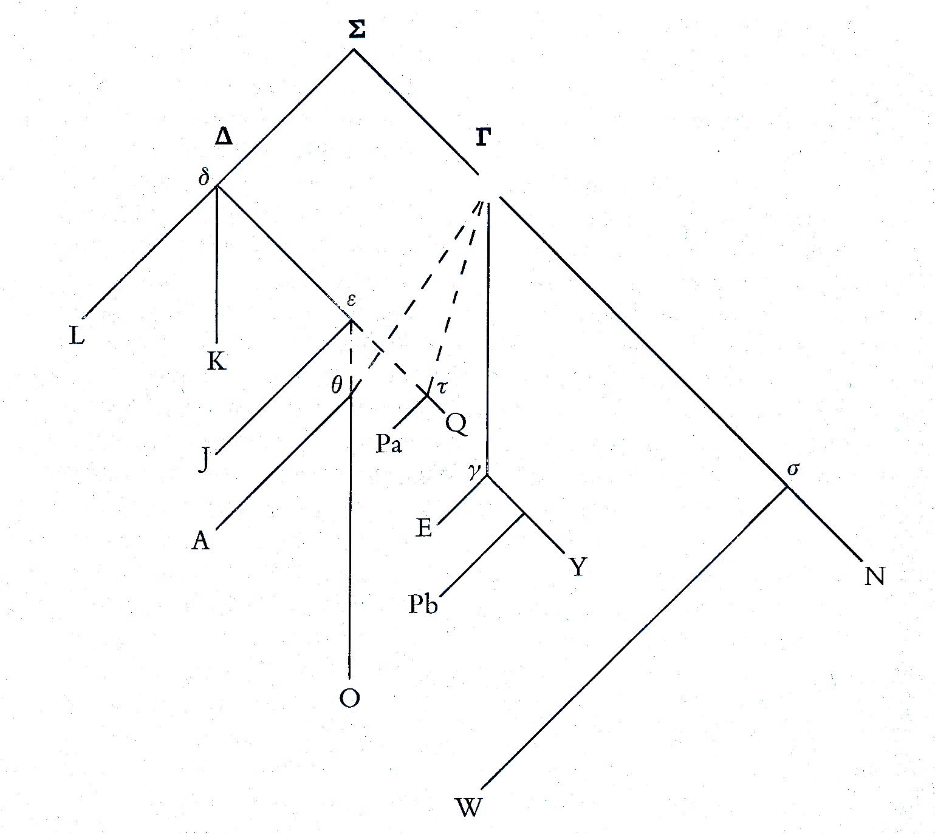
Notes:
Servius has a unique and complicated transmission history, and its really two parallel texts rather than just one text.
STEMMA:
What is shown above is JUST for Servius
There is a whole other tradition for Servius Auctus
Basically, this text is complicated

Slide 7
Notes:
The Caesar example here is fairly in terms of typographical conventions. We have a base text with some paragraph and section numbers, follow by a critical apparatus. This follows a pretty standard model for typesetting critical editions of simple texts like Caesar.
Let’s contrast this to Servius. Shown on the right is one verse from one edition. Because of the strange transmission history, there are a nontrivial number of typographical conventions for representing Servius in print.
Conventions are different in each edition. Even for an experienced textual critic, it is necessary to read the preface for a specific edition of Servius in order to make sense of the text. And I know we ALL read the preface ALL the time, right?
you’ll notice that I had to frankenstein together this verse because in the print edition, it’s split across two pages. We’ve talked a bit in this session about the limitations of print editions, and this is certainly some sort of illustration of something
So far, no one has managed to produce an edition of Servius that is immediately intuitive for readers to understand. I would argue that this is because they focus too much on typesetting and not enough on representing the actual semantic structure of the text. Important to treat text as data in this case.

Slide 8
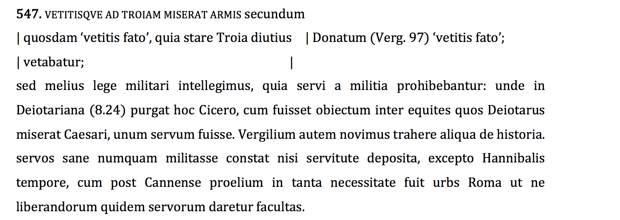
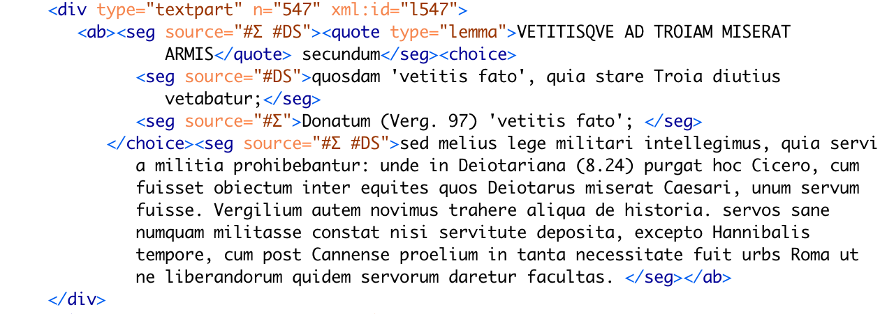
Notes:
Let’s look at these typesetting conventions in more detail
These conventions have meaning to humans looking at the book, but they don’t have any meaning to a computer, or even outside of that specific edition of Servius
Specifically, these refer to what I am calling the TYPE of a section of text
Servius
Auctus
Same
Parallel
The challenge was to get a computer to pick out these conventions, recognize their meaning, and encode them in a way that is meaningful to both humans and computers
Before we discuss how my script processes Servius, we need a 1-minute crash course in object oriented programming

Slide 9
OOPS! You just learned some object oriented programming stuff!
Class: a user-defined data type with fields (internal data) and methods (operations on its data)
Object: one specific instance of a class.
For example, Classicist is a class, and you are an object of class Classicist
Objects know things about themselves
Objects can do things to themselves
The a programmer using a class doesn’t need to know its internal structure or how its methods work

Slide 10
Object Oriented Servius?
Sequential, string-processing based way I was dealing with the other texts was not sophisticated enough to process the structure of this text
Needed a data structure to associate a text string with a type
I chose to represent small pieces of text using the ServThing() class which I designed.
In representing Servius, I chose to use a class rather than an iterable (e.g. dict or list) primarily for ease of use.
Classes provide an intuitive, user-friendly way to interact with text
This is because we can leave type-checking, XML syntax validation, and other tedious, error-prone tasks to the class
Notes:
Because different types of texts need to be processed differently, I needed a persistent way of associating a type with one (or potentially 2, for parallel sections) raw text strings and an XML string.
I briefly considered using a dict or list but ultimately decided to write a ServThing() class
Reasons: ease of use and encapsulation of type-dependent processing to simplify the main method
E.g. each ServThing generates an XML representation of itself
It can do this because it knows its own type
Then, the caller can use thing.xml for any ServThing and be guaranteed a correct XML representation of the object
Reduce processing time by greatly reducing the amount of if statements needed to process one ServThing
Especially important for iterative processing of ServThings, which is what my script does and is likely to be important in other applications
linear-ish time

Slide 11
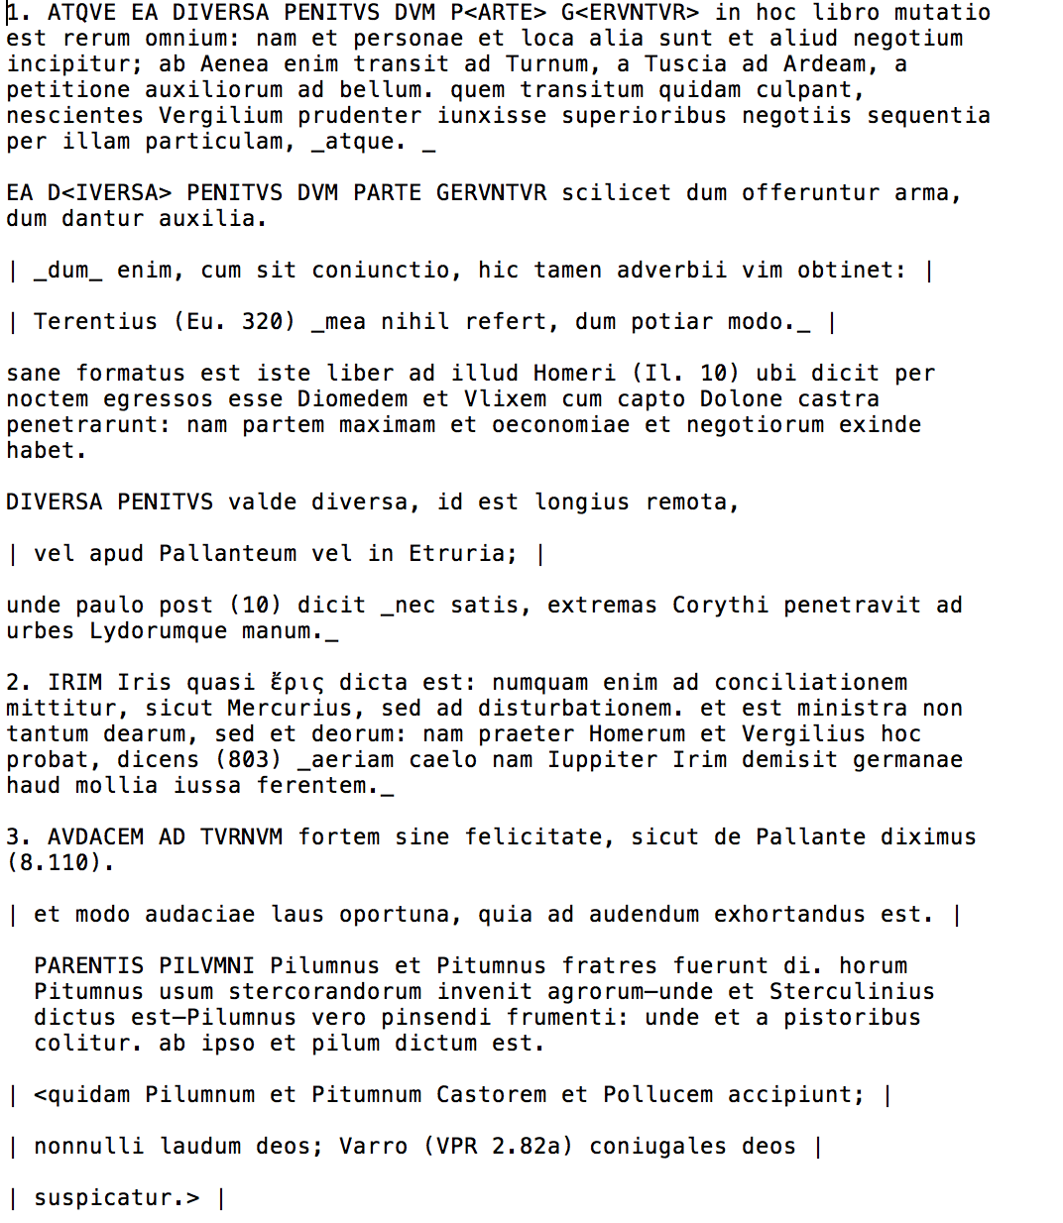
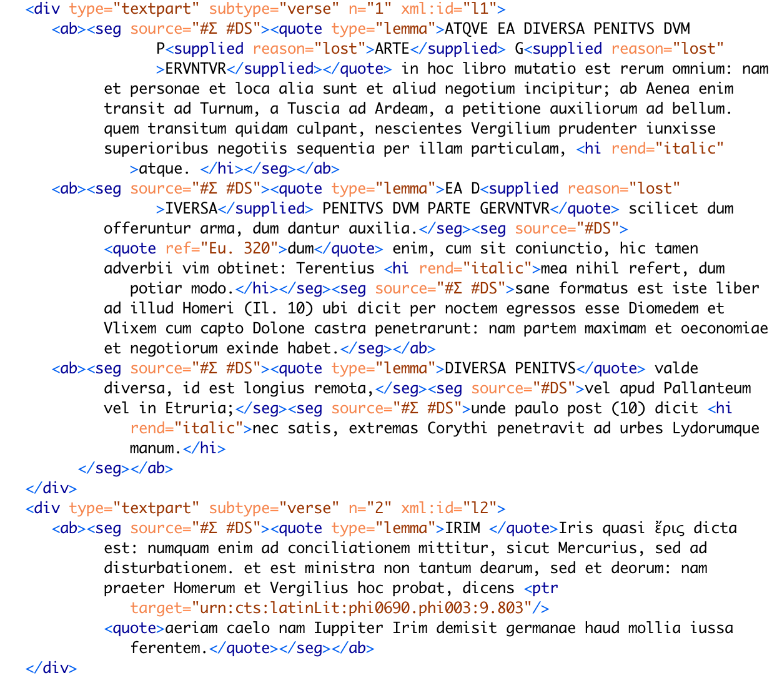
Notes:
Subdivision of the text
Verses (smallest numbered subdivision)
light green boxes
corresponding XML tag is <div type = textpart, subtype = verse>
Lemmas (bits of text referring to the same word/phrase from Vergil) – clarify what is meant by lemma
corresponding XML tag is <ab>
dark green boxes
ServThings (smallest meaningful subdivision – unit of text of one type)
for example, a line that is JUST from Servius or Auctus, or a section from both
correspond to a <seg> tag, or, for parallel sections, a <choice> containing two segs
blue boxes above
Because the internal structure of each element (e.g. number of lemmata in a verse) is variable, it doesn’t make sense to put <div>s in the whole document, then <ab>s, then <seg>s like we did for prose.
Instead, the Servius script uses a nested loop structure. We start by getting a list of all verses in the document. Then, FOR EACH VERSE, we find all the lemmata pertaining to that verse
Similarly, FOR EACH LEMMA, we find all the sections in pertaining to that lemma. Detailed discussion on next slide.

Slide 12
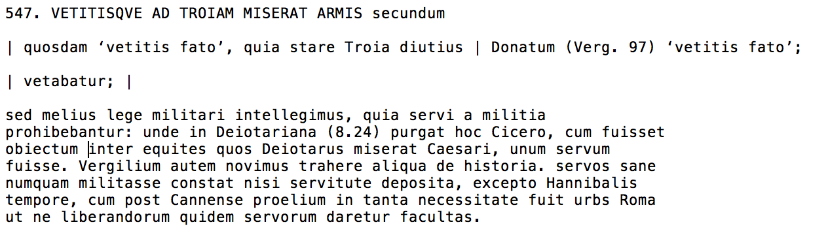
Notes:
Within an <ab>, we split text based on a blank line to break up the <seg>s.
Then, for each seg, we use special markup (pipe characters, tabs at beginning of line, etc) to find the type.
For the first seg in the <ab>, or, if the type is different than the previous type, we make a new <seg> and add it to the <ab>
However, if the type is the same (or if , we have either servius or auctus following a parallel section) we insert the text into the previous section using the addText() method of the ServThing() class. This is significant for two reasons. First, it allows us to put back together text that is typographically separated but semantically goes together, as shown in line 547 above. Second, because the addText() method encapsulates the type-dependent processing, the interface is substantially the same for any combination of types of text, making things much easier for the programmer

Slide 13
Critical Apparatus Processing
Generation of <app> tags and spreadsheet processing is substantially similar between Servius and other texts
The main difference is insertion of generated <app> tags into the main text
For other texts, the numbering specified for the spreadsheet corresponds to the smallest meaningful subdivision of text
For Servius, we have two subdivisions smaller than the smallest numbered subdivision, so we are left with the problem of finding where to put the <app> tag
Currently, we search for each lemma from the beginning of the matching number <div>
The time complexity of this operation is linear in the length of the <div>, and takes on average n/2 time
working on a runtime optimization that will reduce time to find the lemma to almost constant
Notes:
Chose not to require additional numbering because traditional print editions don’t tend to number sections smaller than a verse, and we want to make creating the spreadsheet very intuitive for an editor who is used to working on print editions.
Ok, so I said that the time complexity of this operation is linear, but what does that MEAN?
Computer scientists talk about algorithms in terms of theoretical complexity, which is the approximate mathematical relationship between the size of the input (n) and the running time of the algorithm. In reality, this theoretical number does not predict the exact runtime, but it shows the general trend as inputs get arbitrarily large
In the CS world, an algorithm with linear time is REALLY, REALLY good. There are lots of problems (e.g. sorting a list of numbers) for which a linear solution isn’t possible.
add a witty remark about how talking about complexity is like talk about the stemma to a room full of computer people
trying to keep the complexity of this presentation linear

Slide 14
Demo Time!!!!!!!

Slide 15
Servius: Future Goals
Working on semantically encoding references and text reuse within Servius
Plan to automatically insert CTS URNs to lines in Vergil
Apply the concept object-oriented text representation to other texts
Starting with prose
Develop plain text to object representation and TEI-XML to object representation scripts

Slide 16
Applications of Object-oriented text representation
Vision: a Python library that generates object representations of text from both plain text and TEI-XML inputs
Allows editors to avoid tedious, error-prone tasks like type-checking and XML syntax validation, because the class does it for them!
Application: gives humanities scholars a more accessible interface for interacting programmatically with text
Abstracts away having to deal with XPath and XML syntax
Script generates predictably structured data
Makes it easier to develop and use NLP and analysis tools, like the CLTK!
Notes:
add contact slide to the end

Slide 17
Obligatory closing slide
Scripts here: https://github.com/DigitalLatin/automation/tree/master/python
Documentation here: https://github.com/DigitalLatin/automation/tree/master/guidelines
Servius documentation coming soon!
These slides here: https://tinyurl.com/felknerscs19
Questions? Find me on GitHub (@katyfelkner) or email me at katy.felkner@ou.edu
Thank you for your time!

